Slide 1
Events, Activities & Field Trips
2018/19 Academic Year

Slide 2
Annual BBQ September 4, 2018

Slide 3
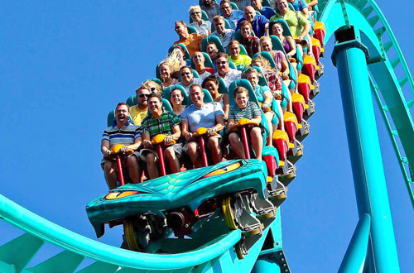
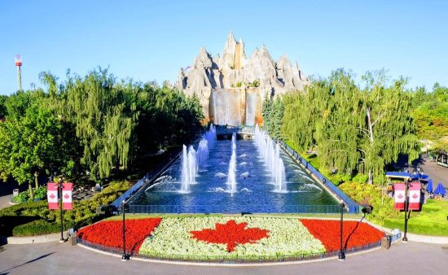
October 5, 2018 Wonderland Field Trip All Day

Slide 4
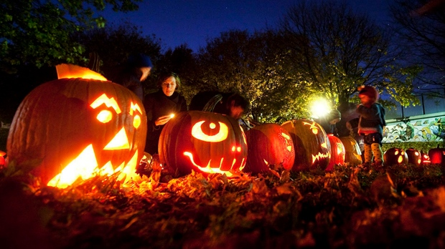
October 31, 2018 Halloween Party

Slide 5
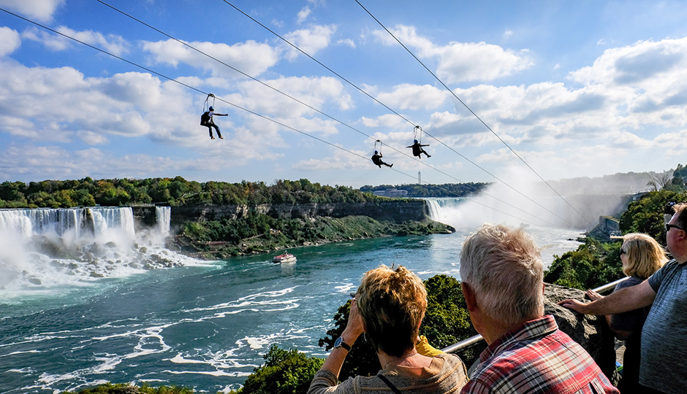
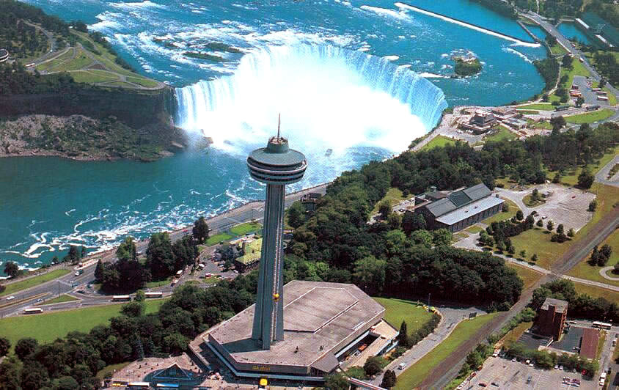
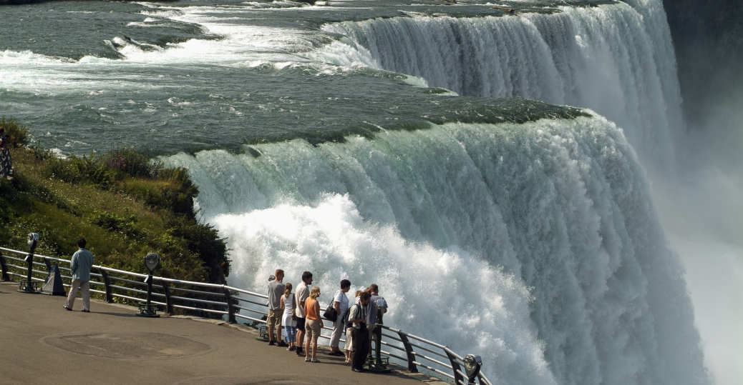
November 30, 2018
Niagara Falls All Day Trip

Slide 6
December 12, 2018 Christmas Party

Slide 7
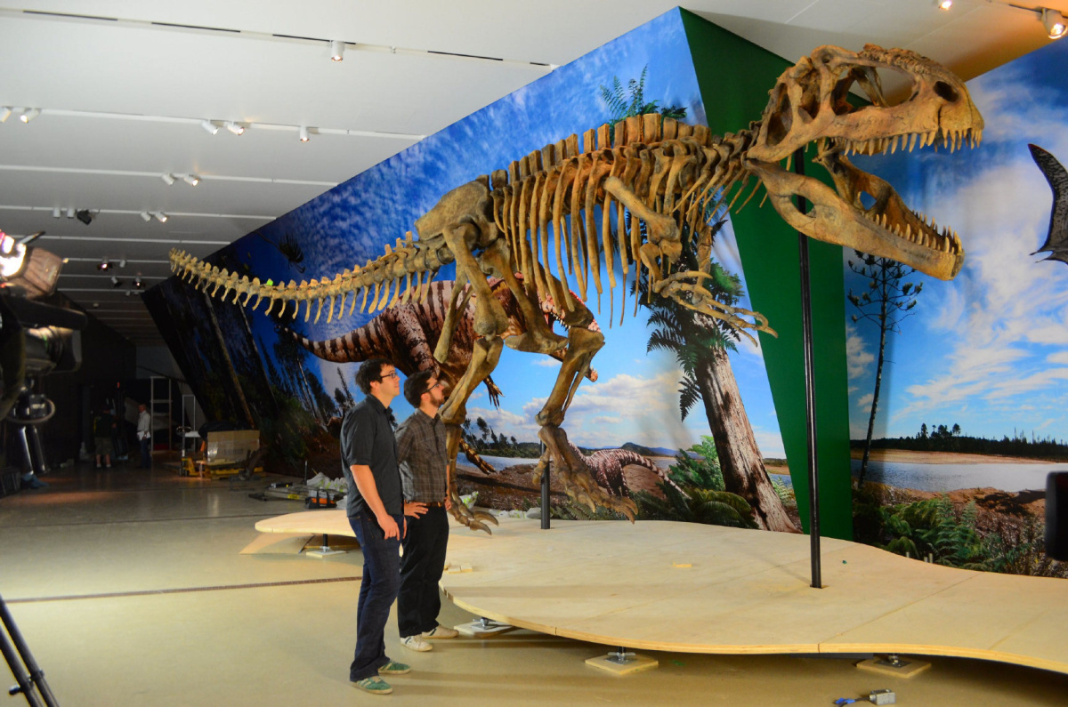
January 25, 2019 ROM-Royal Ontario Museum & Ice Skating

Slide 8
February 6, 2019 Lunar New Year Celebration

Slide 9
February 8, 2019 Photography Competition Exhibition and Awards Distribution

Slide 10
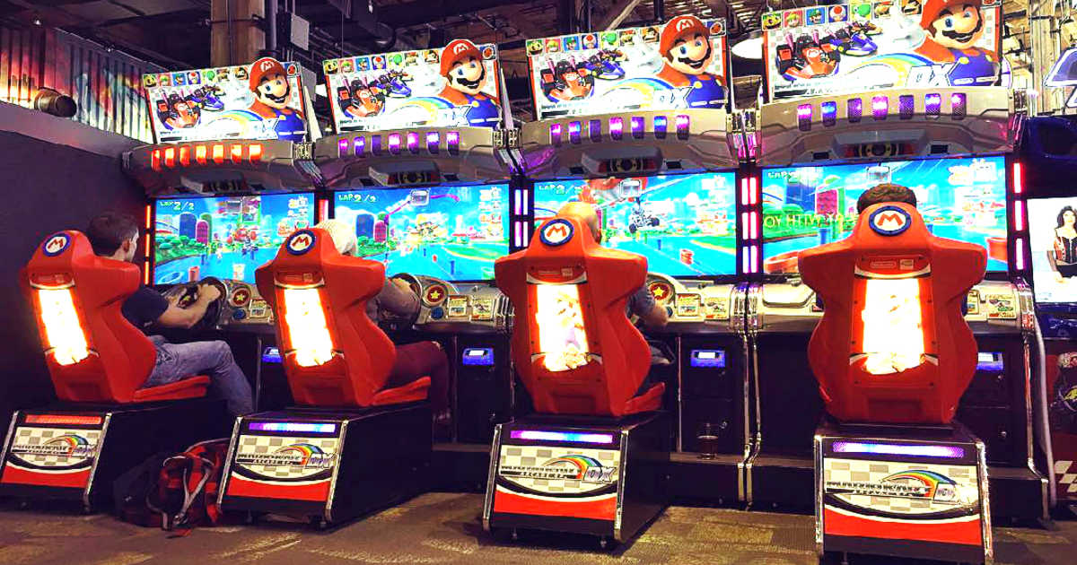
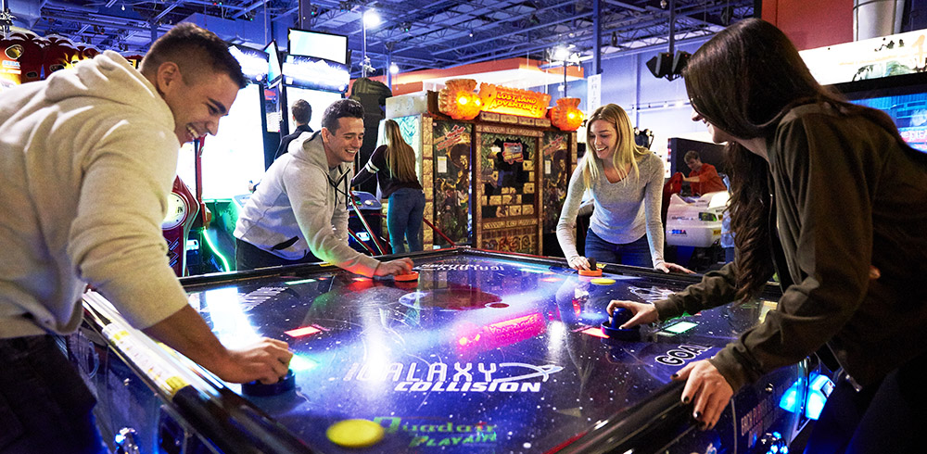
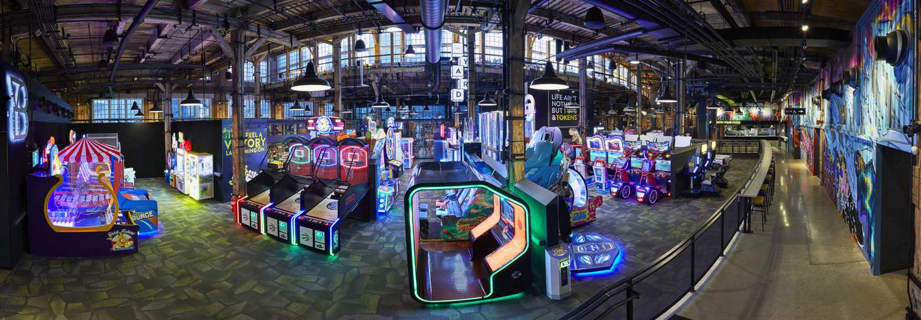
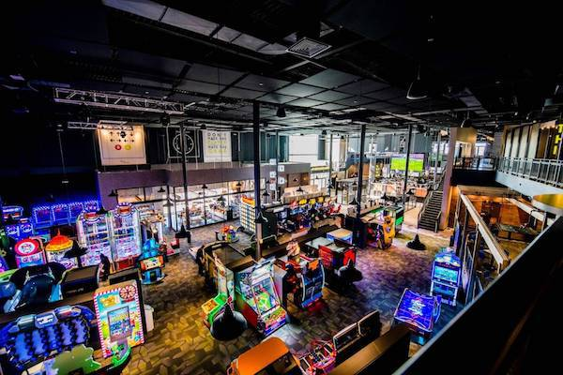
February 15, 2019 The Rec Room

Slide 11
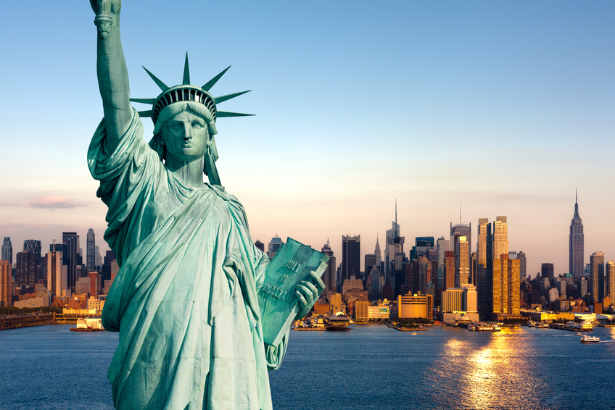
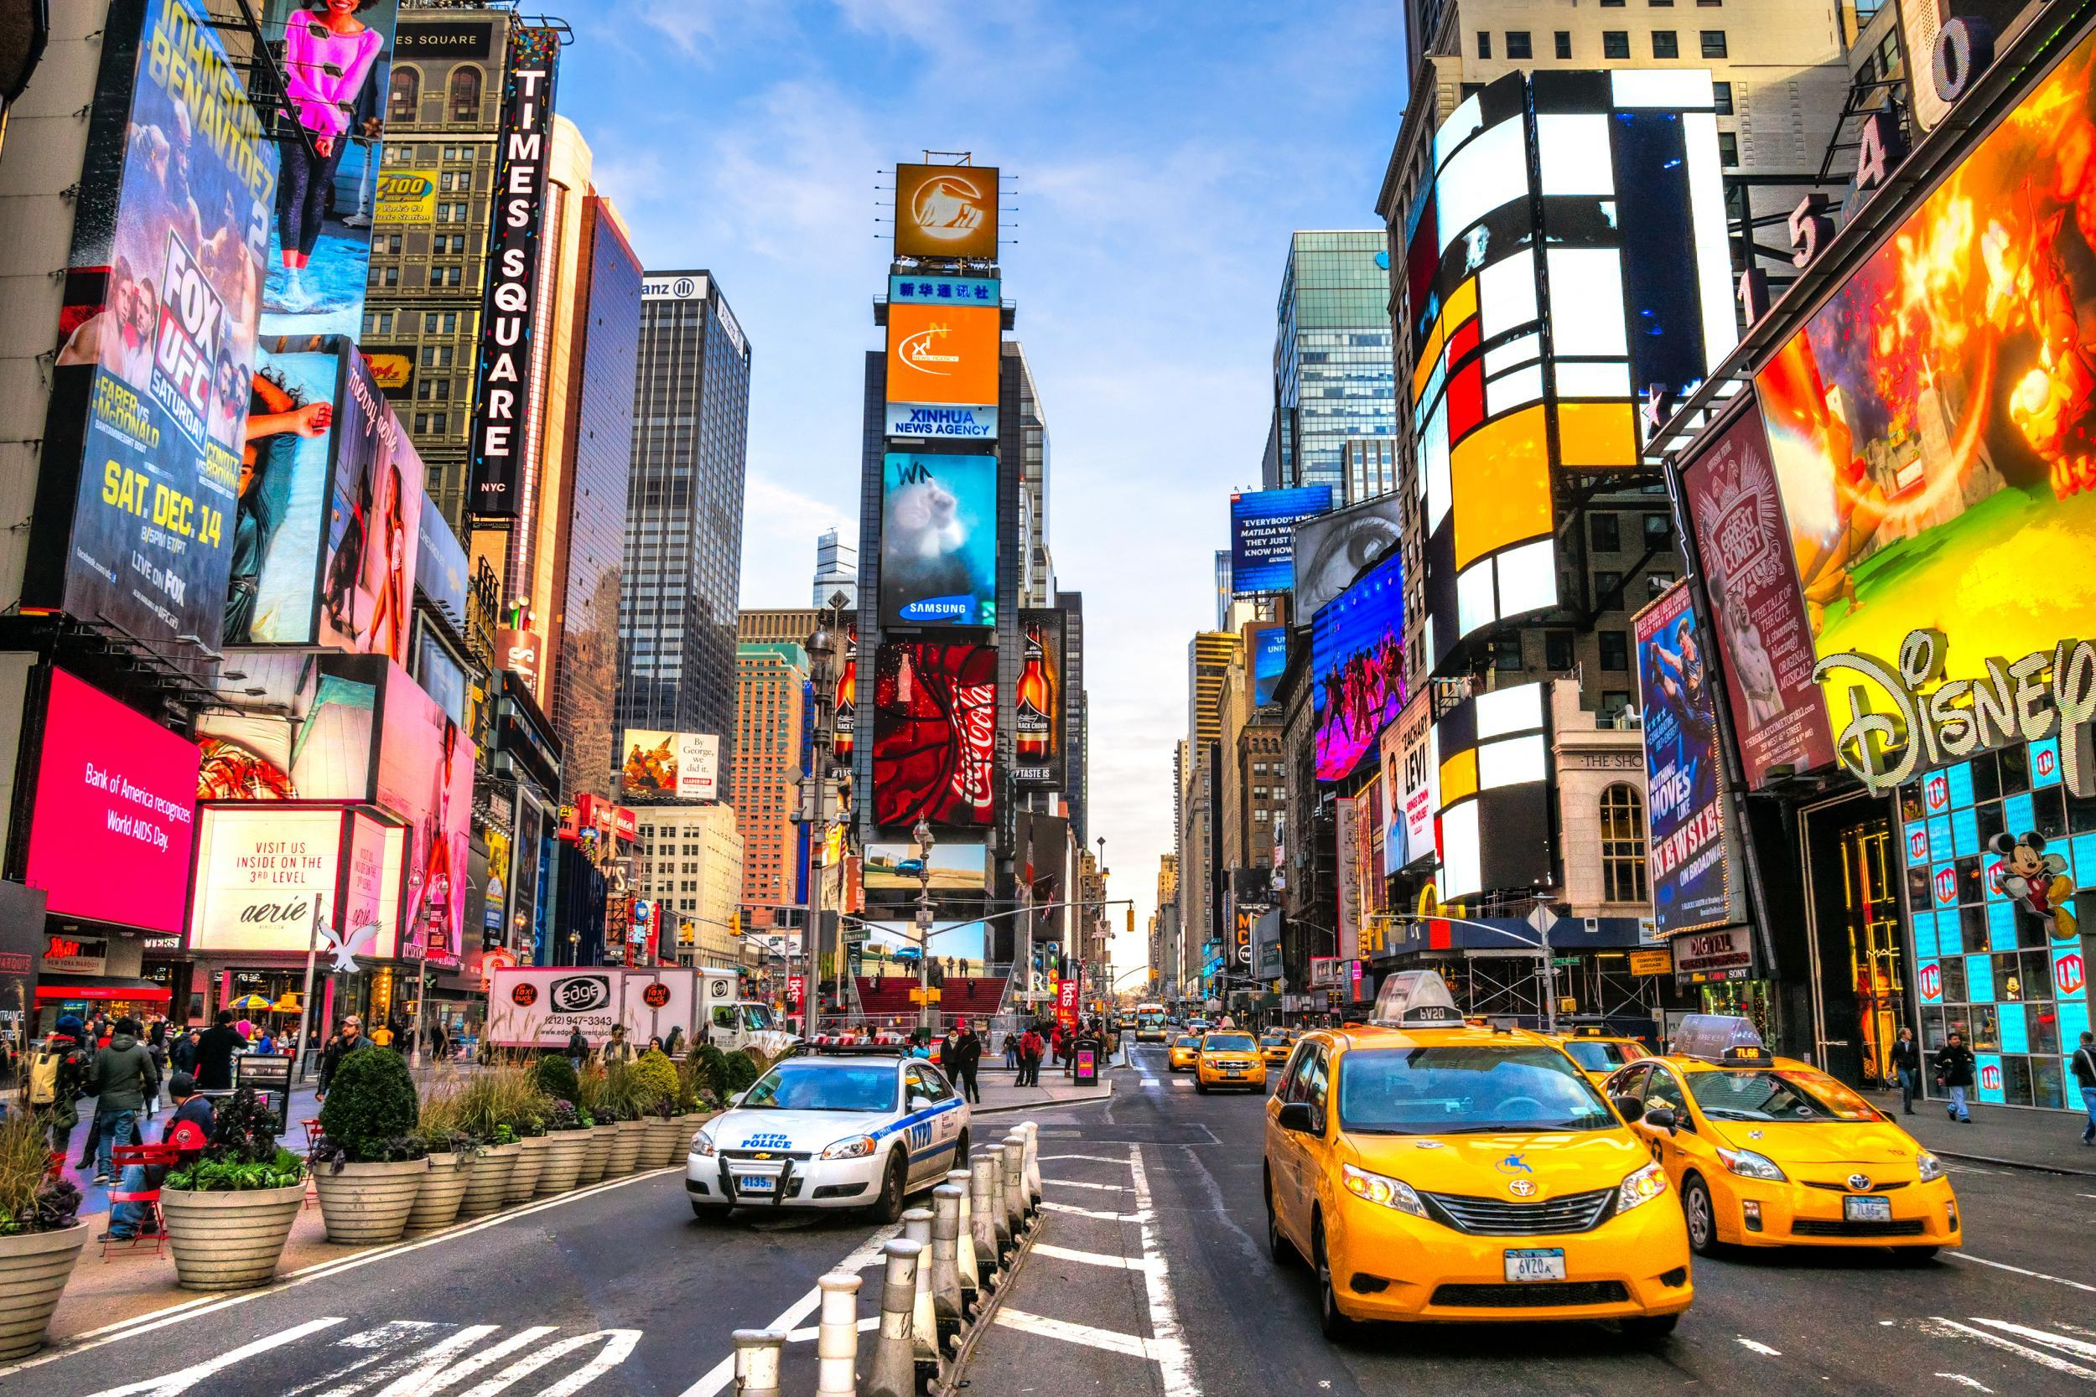
March Break-TBA Trip to New York-USA 3 nights/4 days

Slide 12
April 12, 2019 Best Business Idea Presentations and Awards
"Imagination is more important than knowledge.“ Albert Einstein

Slide 13
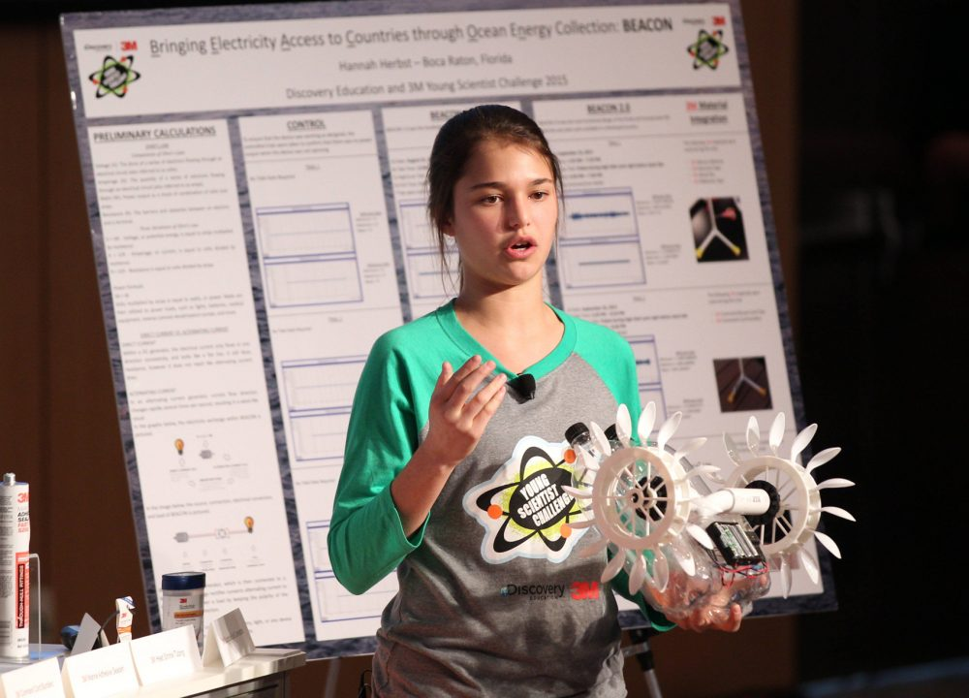
April 25, 2019 STEAM-Fair

Slide 14
April 25, 2019
Writer’s Award Distribution

Slide 15
May 10, 2019 WHS Got Talent
WHS

Slide 16
May 17, 2019 Sports Day

Slide 17
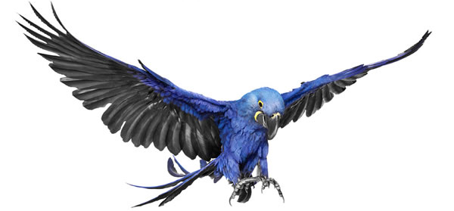
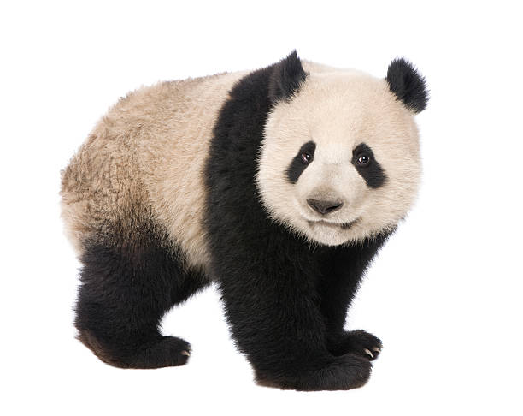
June 7, 2019 Toronto ZOO

Slide 18
June TBA GRADUATION

Slide 19
July 2, 2019 Canada Day Celebrations

