Slide 1
Co-curricular Clubs
2018/19 Academic Year

Slide 2
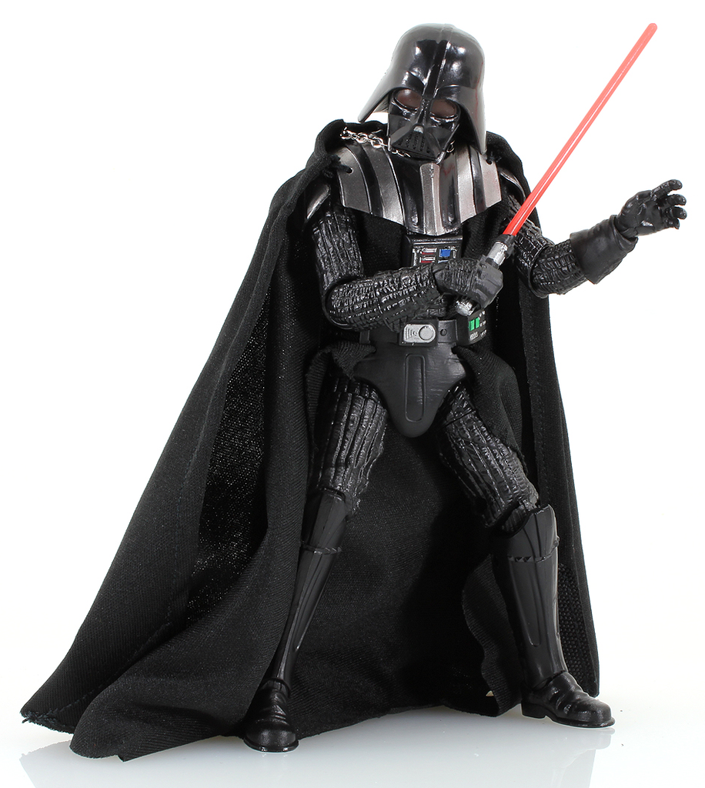
When: Mondays at 12:30—1:20
Where: Room 15
Monday Movie Club

Slide 3
Monday Learn a new language Arts and Crafts Club

Slide 4
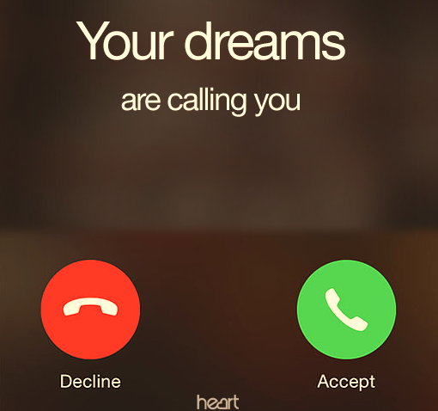
Tuesday University Visits

Slide 5
Wednesday EUCLID Club Debate/Public Speaking

Slide 6
Wednesday EUCLID Club
When: Wednesday at 12:40—1:20
Where: Room 15

Slide 7
Thursday Sports Activities Self Defense
Every THURSDAY from 12:45 p.m. through 1:15 p.m. in Room 8

Slide 8
Friday MUSIC and Choir
Every Friday from 12:45 p.m. through 1:20 p.m. in Room 8

